Slide 1
Developing a Secure Backup and Recovery Solution for iCloud Data on AWS.
Submitted by:
V . SIVANJI
192211429
Guided by:
Dr . Gnana Soundri

Slide 2



Secure Backup and Recovery for iCloud on AWS
Ensuring the safety and availability of your iCloud data is crucial. This presentation explores a comprehensive approach to building a robust backup and recovery solution on AWS, providing peace of mind and data resilience.
by . .

Slide 3


Importance of Protecting iCloud Data
Data Loss Prevention
Compliance and Regulations
Data loss due to device failure, accidental deletion, or cyberattacks can be devastating. Having a secure backup eliminates this risk.
Many industries have strict data storage and security regulations. A secure backup solution ensures compliance and avoids potential penalties.
Business Continuity
Quick and reliable data recovery is vital for business continuity. A well-planned backup strategy allows for a seamless recovery in case of disruptions.

Slide 4


Overview of AWS Cloud Infrastructure
1
Scalability and Flexibility
2
High Availability and Redundancy
AWS offers scalable and flexible resources, allowing you to adjust storage capacity based on your iCloud data growth.
AWS provides multiple availability zones and redundant infrastructure, ensuring continuous data accessibility.
3
Security and Compliance
AWS boasts robust security features and certifications, meeting industry standards for data protection.

Slide 5
Leveraging AWS Services for iCloud Backup
Amazon S3 (Simple Storage Service)
Amazon EBS (Elastic Block Storage)
Amazon Glacier
Long-term archival storage for backups of iCloud data that are rarely accessed. It offers cost-effective storage for cold data.
Cost-effective object storage for storing backups of iCloud data. It offers high durability and scalability.
Block storage volumes for storing backups of iCloud data requiring low latency and high performance.

Slide 6
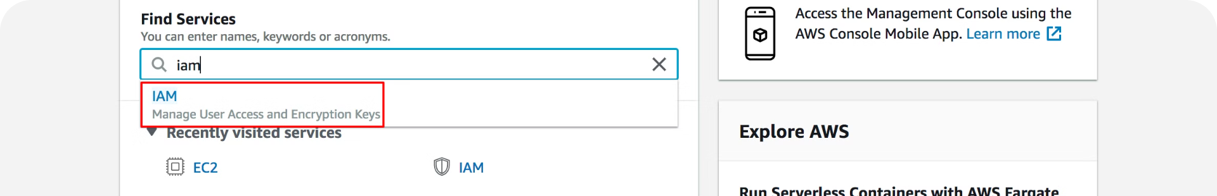
Configuring AWS Storage Solutions
Storage Tier Selection
1
Choose the appropriate storage tier based on your data access frequency and cost considerations. Select S3 Standard, S3 Infrequent Access, or S3 Glacier.
2
Encryption at Rest and in Transit
Implement strong encryption to protect your iCloud data both when stored in AWS and during data transfer. Utilize AWS KMS (Key Management Service).
Access Control and Permissions
3
Set up granular access control to restrict access to your iCloud backups. Grant specific permissions to authorized users or applications.

Slide 7




Automating Backup Processes
Scheduled Backups
Incremental Backups
Versioning and Retention
Automate regular backups of your iCloud data using AWS services like AWS Lambda and CloudWatch Events. Set up schedules based on your needs.
Only back up changes made to your iCloud data since the last backup, significantly reducing backup time and storage requirements.
Implement versioning and retention policies to retain multiple backup copies and ensure recovery from previous states of your iCloud data.

Slide 8

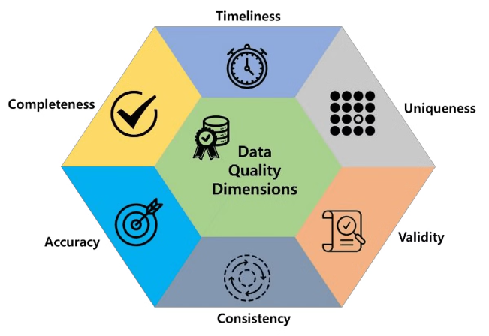
Ensuring Data Integrity and Reliability
Data Verification
Implement checksums and data hashing algorithms to validate data integrity and ensure that backups are accurate.
Data Replication
Replicate your iCloud backups across multiple availability zones for redundancy and fault tolerance. Utilize Amazon S3's Cross-Region Replication.
Monitoring and Alerts
Set up monitoring and alerting systems to detect any issues with your backups, ensuring proactive problem detection and resolution.

Slide 9
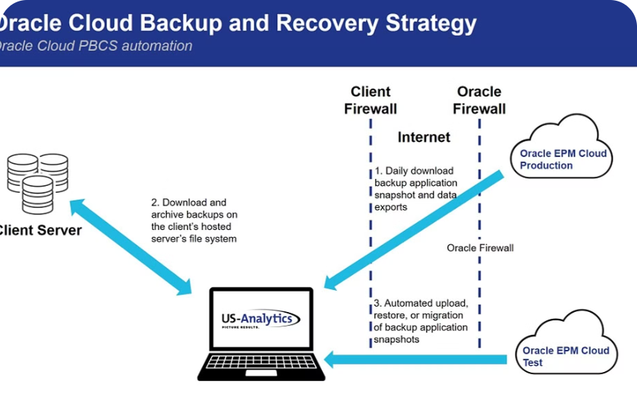
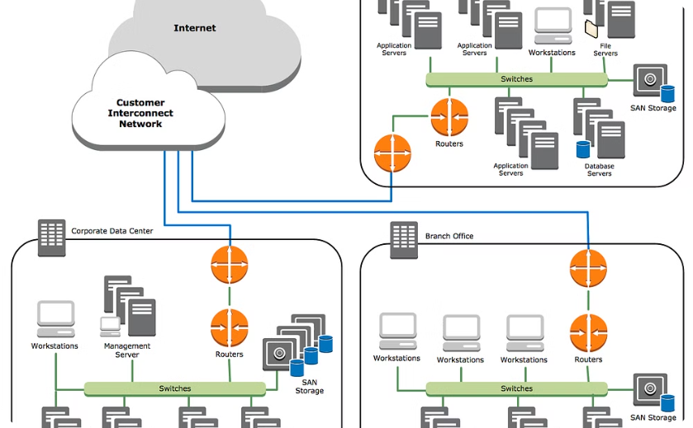
Implementing Disaster Recovery Strategies
Disaster Recovery Plan
Data Recovery Testing
Develop a comprehensive disaster recovery plan that outlines the steps to recover your iCloud data in the event of a disaster. This plan should include procedures for restoring data, testing recovery procedures, and communicating with stakeholders.
Regularly test your disaster recovery plan to ensure its effectiveness and identify any gaps or inconsistencies. This will validate your recovery procedures and provide confidence in your backup solution.

Slide 10


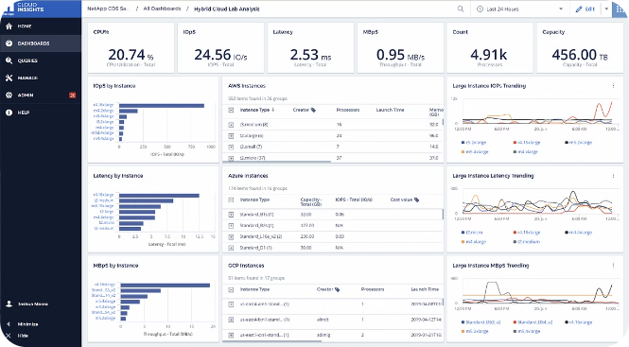


Monitoring and Alerting for Backup Health
AWS CloudWatch
Use AWS CloudWatch to monitor your backup processes, including storage capacity, backup duration, and data integrity. Configure alarms to notify you of any issues.
Alerting Systems
Set up alerts to notify you of critical events, such as failed backups, storage capacity issues, or data integrity violations. Utilize AWS SNS (Simple Notification Service).
Performance Metrics
Track key metrics related to your iCloud backups, such as backup frequency, transfer rates, and storage utilization. This helps you identify potential bottlenecks or areas for optimization.

Slide 11

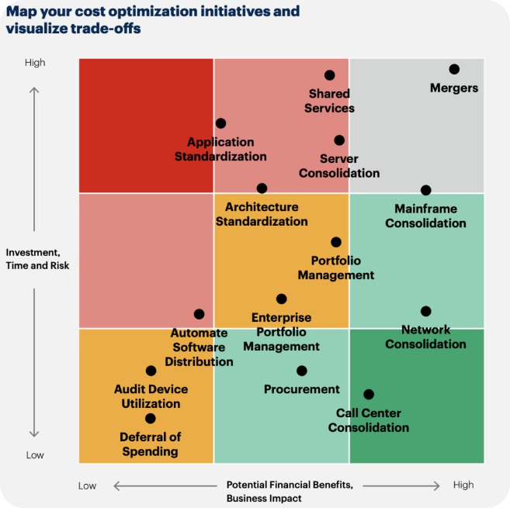
Optimizing Cost and Performance
1
Storage Tier Optimization
Regularly review your storage tiers and adjust them as needed to optimize costs. Archive less frequently accessed data to S3 Glacier for cost savings.
2
Backup Frequency and Retention Policies
Optimize backup frequency and retention policies based on your data sensitivity and regulatory requirements. This balances data security and cost efficiency.
3
Data Compression and Deduplication
Utilize data compression and deduplication techniques to reduce backup storage requirements and improve backup performance. Leverage AWS services like Amazon S3's object-level deduplication.

Slide 12


